Slide 1
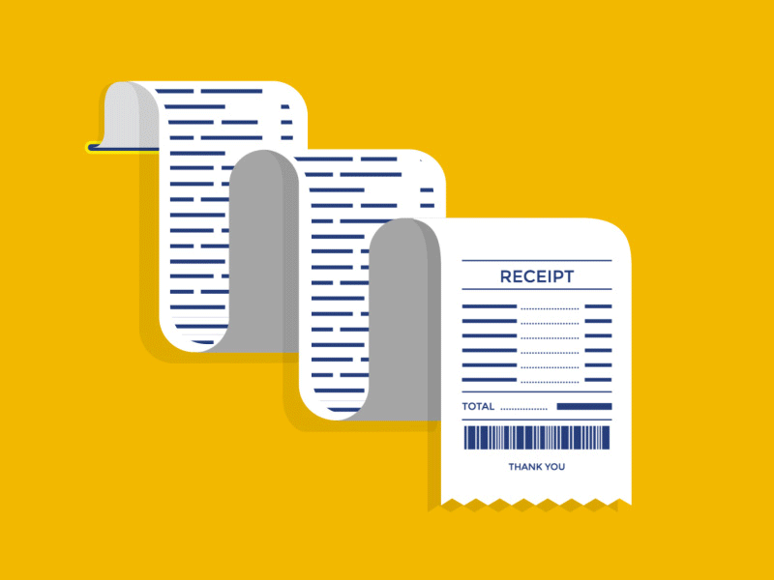
BILLING SYSTEM
RAHUL BOTHRA 9245
SAMUEL EMMATTY 9256
HARSH KADAM 9263
ASHER LOPES 9268

Slide 2
INTRODUCTION
The project is "Bakery billing system" software for monitoring and controlling the transaction in bakery.
Bakery BILLING SYSTEM is a window application designed to help users to maintain and organize bills . The system processes transaction and stores the resulting data. Reports will be generated from these data which help the bakery manager to make appropriate business decisions for the bakery.

Slide 3
CONCEPT USED
1.AWT Package:Java AWT (Abstract Window Toolkit) is an API to develop Graphical User Interface (GUI) or windows-based applications in Java. Java AWT components are platform-dependent i.e. components are displayed according to the view of the operating system.
2. Swing Package:Java Swing tutorial is a part of Java Foundation Classes (JFC) that is used to create window-based applications. It is built on the top of AWT (Abstract Windowing Toolkit) API and entirely written in java. Unlike AWT, Java Swing provides platform-independent and lightweight components. The javax.swing package provides classes for java swing API such as JButton, JTextField, JTextArea, JRadioButton, JCheckbox, JMenu, JColorChooser etc.
3.Jframe Class :The javax.swing.JFrame class is a type of container which inherits the java.awt.Frame class. JFrame works like the main window where components like labels, buttons, text fields are added to create a GUI.

Slide 4
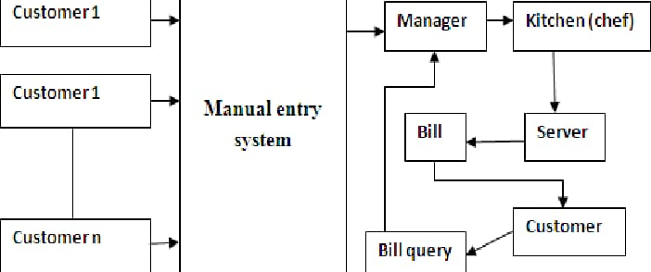
BLOCK DIAGRAM

Slide 5
LITERATURE SURVEY
Culinary business is a business opportunity that is most in-demand, E Bill Resto is a restaurant billing system that was developed by involving several selling places/restaurants with the name of a brand that is connected to the parent company by a database server. With an integrated system, all revenue from restaurant sales can be monitored in real time.
The Master Application as a provider of Embedded Data Service Web resources on 3 Restaurant Information Systems, It does the synchronization of 3 Web Service Clients, Data From the Master-Slave Side was obtained by testing 3 data sampling,

Slide 6
Problem Statement
Nowadays, billing process is done either manually or using barcode readers which are highly time consuming. Moreover, barcodes are susceptible to damage and failure rate in barcodes are relatively high. In order to overcome these disadvantages, the billing process has to be automated. This is done using RFID technology.

Slide 7
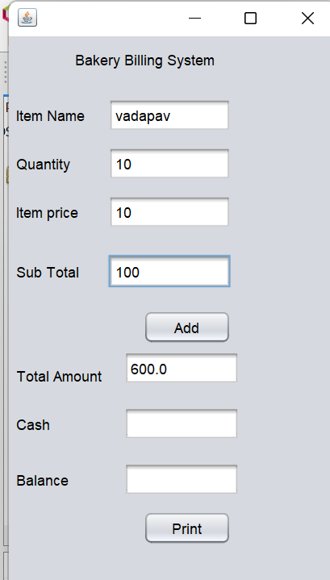
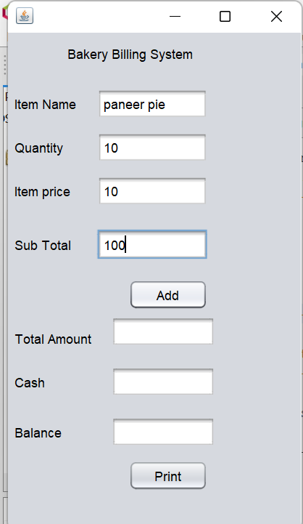
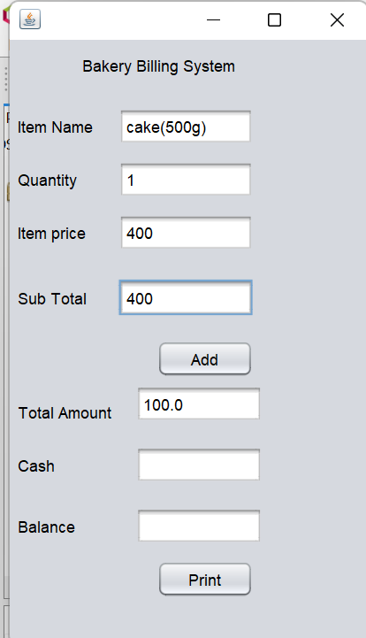
OUTPUT:

Slide 8
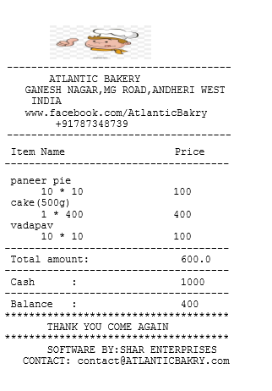
OUTPUTS

Slide 9
References
[1] Putra, R. E., Izzati, B. M., and F. Dewi, “Point Of Sale (POS) Performance Optimization With Database Synchronization Implementation Using Middleware”. Informatika Mulawarman : Jurnal Ilmiah Ilmu Komputer, 12(2), 123, 2017.
[2] Malhotra, N., & Anjali, C., “Implementation of Database Synchronization Technique between Client and Server”. International Journal of Engineering Science and Innovative Technology (IJESIT), 3(4), 460–465, 2014.
[3] Lin, Y., Kemme, B., Patiño-Martínez, M., & Jiménez-Peris, R., “Middleware based Data Replication Providing Snapshot Isolation”. In Proceedings of the 2005 ACM SIGMOD International Conference on Management of Data - SIGMOD ’05 (419), 2005.

Slide 10
THANK YOU
STAY HOME STAY SAFE :)

